Slide 1
An Introduction to Group Theory
HWW Math Club Meeting (March 5, 2012)
Presentation by Julian Salazar

Slide 2
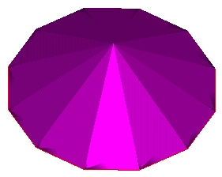
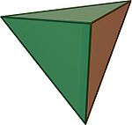
Symmetry
How many rotational symmetries?

Slide 3
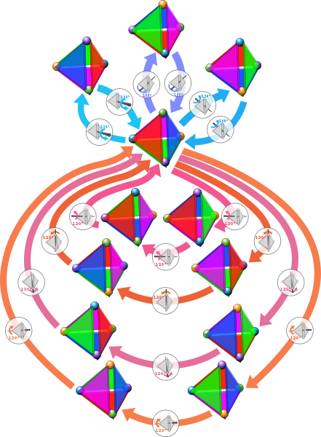
Symmetry

Slide 4
Symmetry
So the 6-pointed snowflake, 12-sided pyramid, and the regular tetrahedron all have the same number of rotational symmetries…
But clearly the “nature” of their symmetries are different!
How do we describe this?

Slide 5
Symmetry
Numbers measure size.
Groups measure symmetry.

Slide 6
Terminology
Set: A collection of items. Ex: $S=\{a,b,c\}$
Element: An item in a set. Ex: $a∈S$
Binary operator: An operation that takes two things and produces one result. Ex: +, ×

Slide 7
Formal Definition
A group is a set $G$with a binary operation $∗$. We can notate as $(G,∗)$ or simply $G$. We can omit the $∗$ symbol.
It must satisfy these properties (axioms):
Closed: If $a,b$ $are in G$, $ab$ is in$G.$
Associative: $\left(ab\right)c=a(bc)$
Identity: There exists $e$such that $ae=a=ea$ for every $a$ in $G$. ($∃ e∈G :ae=e=$ $ea ∀ a∈G$)
Inverse: For every $a$ in $G t$here exists $a^{−1}$such that $aa^{−1}=e=a^{−1}a$.$(∀ a∈G ∃ a^{−1}∈G :aa^{−1}=e=a^{−1}a$)

Slide 8
Example: ($ℤ$,+)
The integers under addition are a group.
Closed: Adding two integers gives an integer
Associative: It doesn’t matter how you group summands; (3+1)+4 = 3+(1+4)
Identity: Adding an integer to 0 gives the integer
Inverse: Adding an integer with its negative gives 0
Is $(ℝ−\{0\}$, ×) a group?
Is $(\{±1, ±i\}$, ×) a group?

Slide 9
Identities are UNIQUE
Theorem: For any group, there’s only one identity $e$.
Proof: Suppose $e,e′$ are both identities of $G$.
Then $e=ee^{′}=e′$.
Ex: For ($ℤ$,+), only 0 can be added to an integer to leave it unchanged.

Slide 10
Inverses are UNIQUE
Theorem: For every$a$ there is a unique inverse $a^{−1}$.
Proof: Suppose $y,z$ are both inverses of $x$.
Then $xy=yx=e$ and $zx=xz=e$.
$$y=ey=\left(zx\right)y=z\left(xy\right)=ze=z$$
Ex: In ($ℤ$,+), each integer has a unique inverse, its negative. If $a=3$, $a^{−1}=−3$.

Slide 11
Composition (A note on notation)
Composition is a binary operator.
Take functions $f(x)$ and $g(x)$.
We compose $f$and $g$ to get $fg.$
$fg\left(x\right)=f\left(g\left(x\right)\right)$, so we evaluate from right to left.
$fg$ means $g$ first, then $f$.

Slide 12
Let’s “Group” our Symmetries
Let $e$ be doing nothing (identity)
Let the binary operation be composition
Let $r$ be rotation 1/12th clockwise
So $rr=r^{2}$ means…
rotating $1/6$^{th} of the way clockwise!
$G=\{e,r,r^{2},r^{3},…,r^{11}\}$

Slide 13
Let’s “Group” our Symmetries
$G=\{e,r,r^{2},r^{3},…,r^{11}\}$
Closed: No matter how many times you rotate with $r$, you’ll end up at another rotation
Associative: Doesn’t matter how you group the rotations
Identity: You can do nothing
Inverse: If you rotate by $r^{n}$, you must rotate $r^{12−n}$ to return to the original state

Slide 14
Let’s “Group” our Symmetries
$G=\{e,r,r^{2},r^{3},…,r^{11}\}$
What is rotating counter-clockwise then?
It’s $r^{−1}$ (the inverse of $r$).
But wait! $r^{−1}= r^{11}$.
So $r\left(r^{11}\right)=e$. In plain words, rotating 1/12th twelve times gets you back to where you started =O

Slide 15
Let’s “Group” our Symmetries
$G=\{e,r,r^{2},r^{3},…,r^{11}\}$
But inverses aren’t unique! $r\left(r^{23}\right)=e$, right?
Yeah, but the net effect of $r^{23}$ is the same as that of $r^{11}$.
So in our set, we only have $r^{11}$.
We only count “unique” elements for our group.

Slide 16
Let’s “Group” our Symmetries
Let $e$ be doing nothing (identity)
Let the binary operation be composition
Let $r$ be rotating the sign 1/8th clockwise
Let $s$be flipping the sign over
$G=\{e,r,r^{2},…r^{7}, s,rs,r^{2}s,…,r^{7}s\}$

Slide 17
Let’s “Group” our Symmetries
$G=\{e,r,r^{2},…r^{7}, s,rs,r^{2}s,…,r^{7}s\}$
Closed: No matter which rotations you do, you’ll end up at one of the 16 rotations
Associative: Doesn’t matter how you group the rotations
Identity: You can do nothing
Inverse: You can always keep rotating to get back to where you started

Slide 18
Let’s “Group” our Symmetries
$G=\{e,r,r^{2},…r^{7}, s,rs,r^{2}s,…,r^{7}s\}$
What is $s^{−1}?$
What is ${\left(r^{2}s\right)}^{−1}$?
What is $r^{2}sr^{2}s?$
What is $r^{4}s^{2}$?
$r^{2}sr^{2}s≠r^{4}s^{2}$.
We’re not multiplying ($ab$not necessarily $=ba$)

Slide 19
Categorizing Groups
Cyclic groups: Symmetries of an $n$-sided pyramid.
Note: ($ℤ$,+) is an infinite cyclic group.
Dihedral groups: Symmetries of a $n$-sided plate.
Other:
Permutation groups: The permutations of $n$ elements form a group.
Lie groups, quaternions, Klein group, Lorentz group, Conway groups, etc.

Slide 20
Isomorphism
Consider a triangular plate under rotation.
Consider the ways you can permute 3 elements.
Consider the symmetries of an ammonia molecule.
They are ALL the same group, namely
$$\{e,r,r^{2},s,rs,r^{2}s\}$$
Thus the three are isomorphic.
They fundamentally have the same symmetry.

Slide 21
Groups are NOT arbitrary!
Order: # of elements in a group
There are only 2 groups with order 4:
$\{e,r,r^{2},r^{3}\}$, $\{e,r,s,rs\}$
There are only 2 groups with order 6: $\left\{e,r,r^{2},r^{3},r^{4},r^{5}\right\}, \{e,r,r^{2},s,rs,r^{2}s\}$
B$ut {there}^{′}s only$ 1 group with order 5!?
$$\left\{e,r,r^{2},r^{3},r^{4}\right\}$$

Slide 22
Using Groups
With groups you can:
>>Measure symmetry<<
Express the Standard Model of Physics
Analyze molecular orbitals
Implement public-key cryptography
Formalize musical set theory
Do advanced image processing
Prove number theory results (like Fermat’s Little Theorem)
Study manifolds and differential equations
And more!

